Slide 1
Spectral classification II

Slide 2
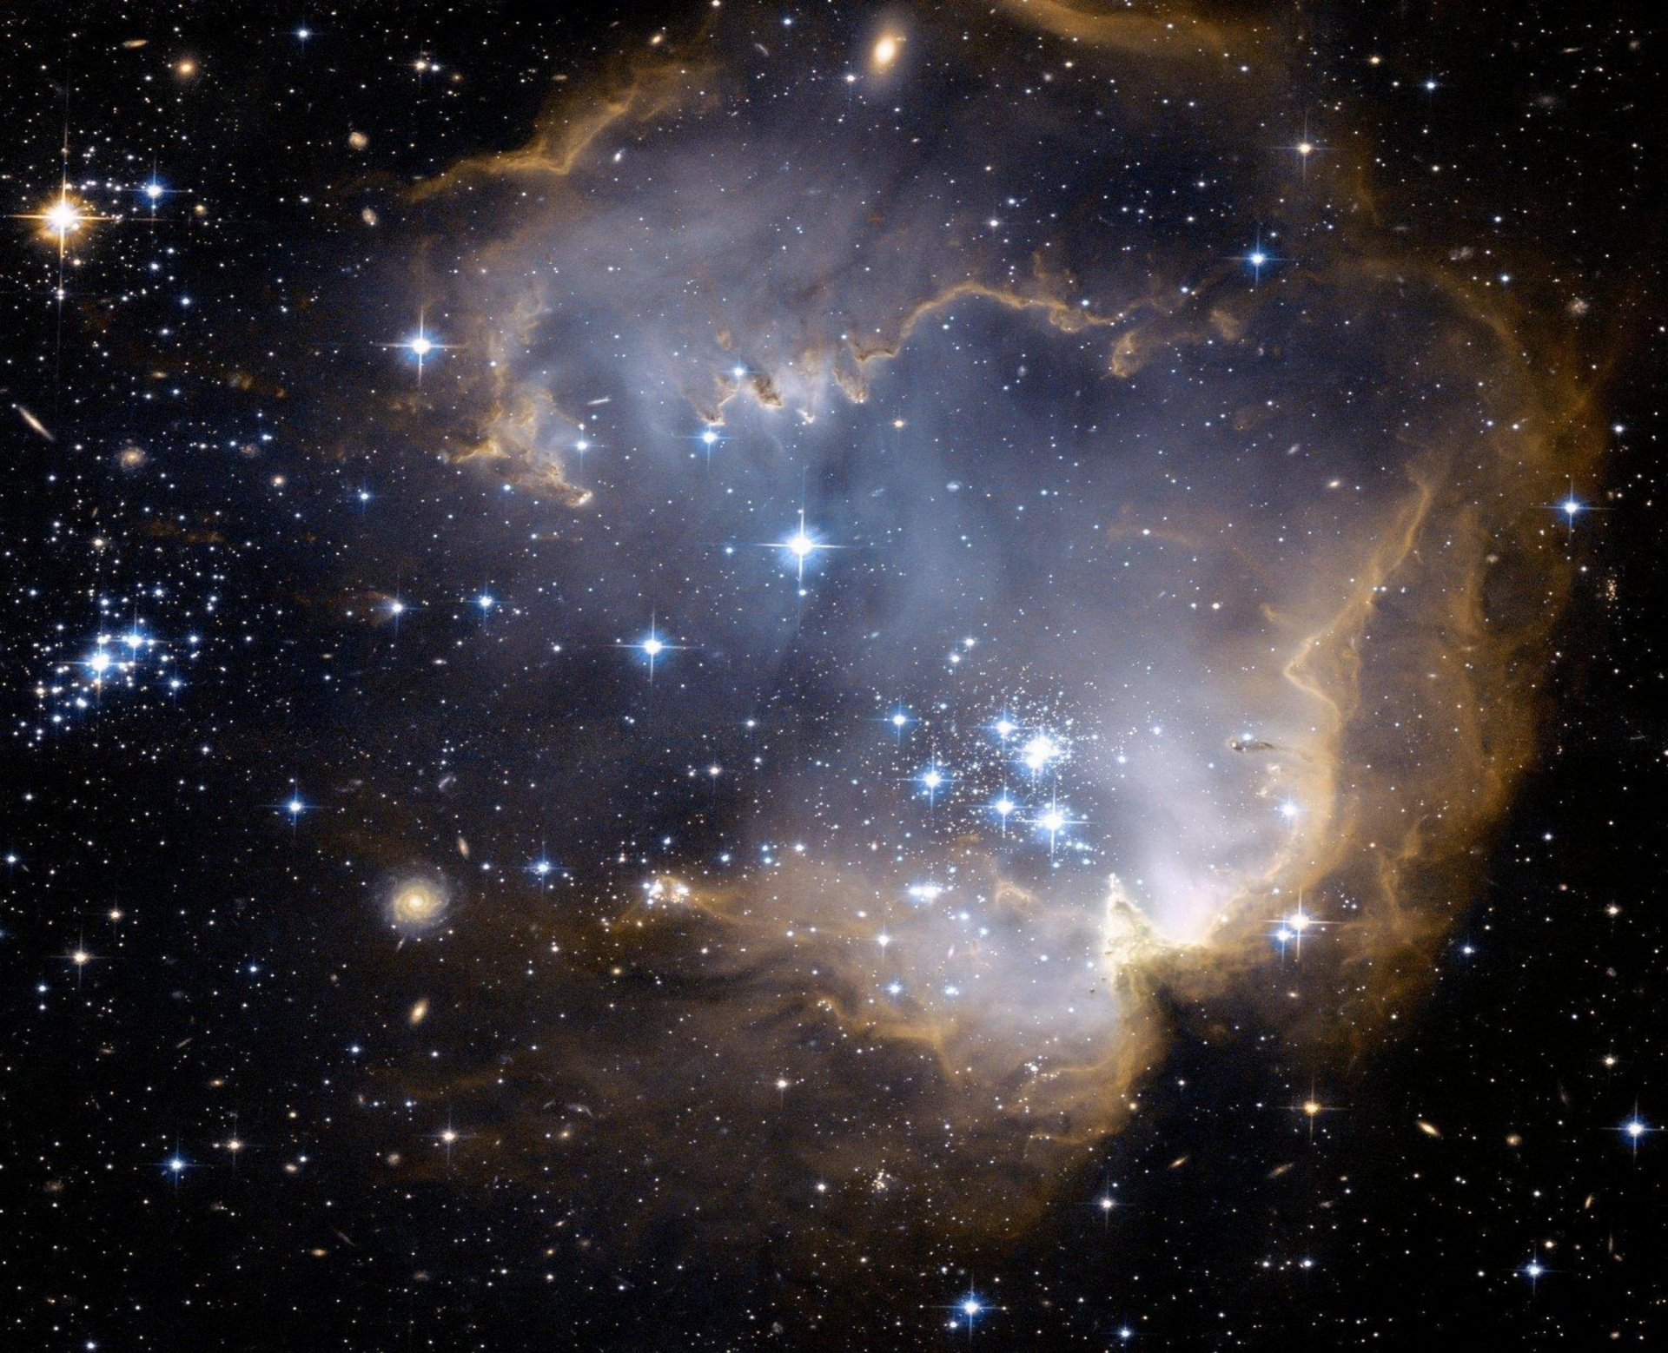
STARTER:
Do you think stars are similar in composition as Earth , or they are different? Do stars vary wildly in composition or they are similar?

Slide 3
The chemical composition of the stars
In the early days of astrophysics, scientists thought that the stars were probably similar to the Earth in chemical composition. When they passed starlight through a prism and examined the resulting spectrum, they found absorption (and occasionally emission) lines of many elements common here on Earth.

Slide 4
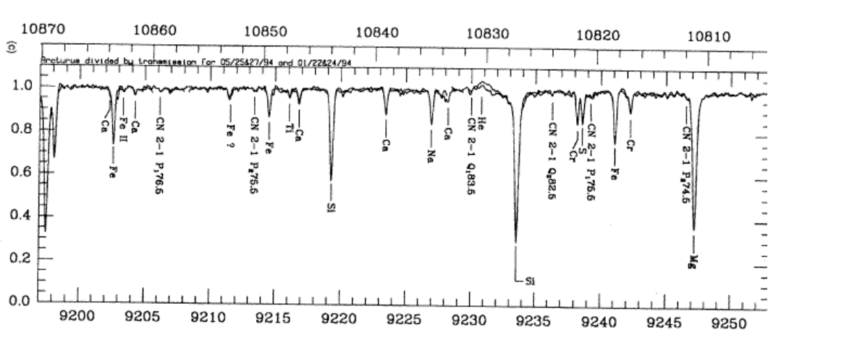
For example, here's a portion of the spectrum of Arcturus (taken from a paper by Hinkle, Wallace and Livingstone, PASP 107, 1042, 1995):

Slide 5
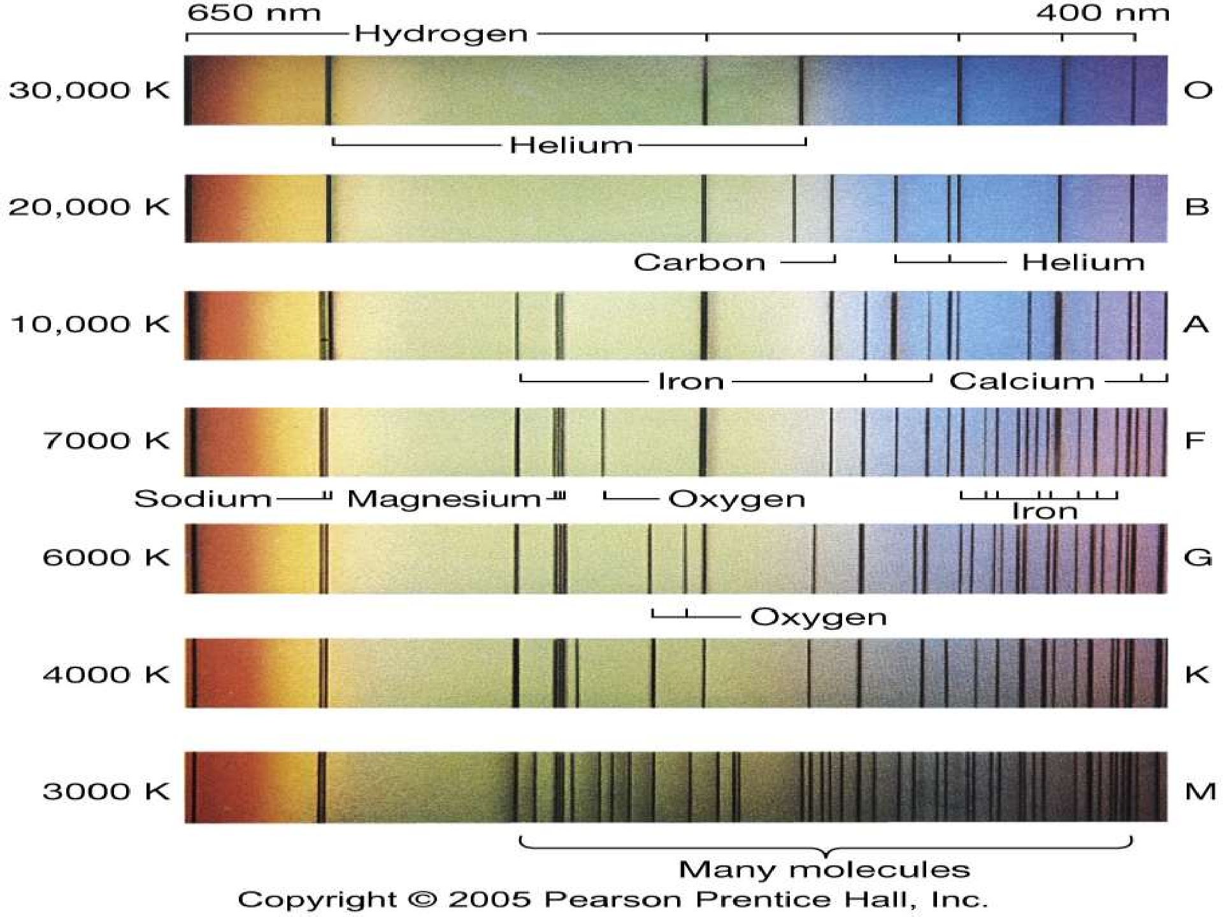
Now, different stars have spectra which look very different

Slide 6
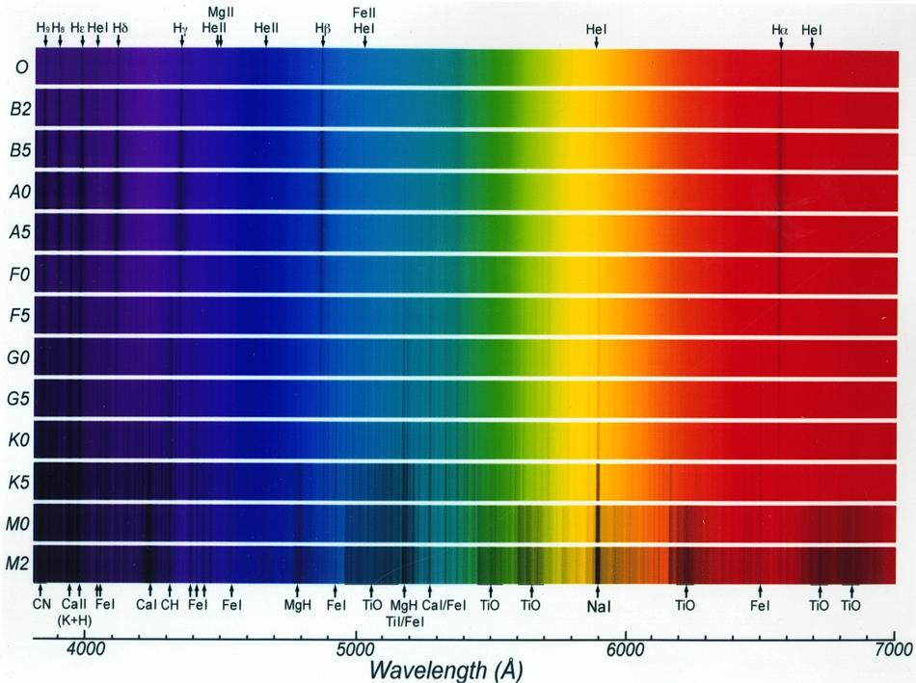
Stellar spectra
Stellar spectra show interesting trends as a function of temperature:
Increasing temperature

Slide 7
Does this mean that the chemical composition of stars varies wildly? Initially, scientists thought the answer was "yes."
In the nineteen-twenties, Cecilia Payne studied the spectra of stars, and devised a way to figure out the temperature and true chemical composition of stars. She concluded that the atmospheres of stars were
NOT made up of the same mix of elements as the Earth
NOT wildly variable in composition

Slide 8
but in fact,almost entirely hydrogen, in almost all stars
This was so surprising that scientists ignored or rejected the idea for several years. Eventually, after further study confirmed Payne's work, the astronomical community had to concede that the stars were, in fact, very different from the Earth. They appeared to be made up of
90% hydrogen (by number of atoms)
10% helium
tiny traces of heavy elements (everything else)

Slide 9
Stellar spectra
Stellar spectra show interesting trends as a function of temperature:
Increasing temperature

Slide 10
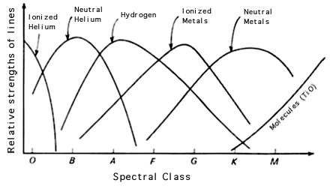
Review: spectral classes
Spectral Type | Colour | Temperature (K) | Main characteristics | Example
O | Blue-white | >25000 | Strong HeII absorption (sometimes emission); strong UV continuum | 10 Lacertra
B | Blue-white | 11000-25000 | HeI absorption, weak Balmer lines | Rigel
A | White | 7500-11000 | Strongest Balmer lines (A0) | Sirius
F | Yellow-white | 6000-7500 | CaII lines strengthen | Procyon
G | Yellow | 5000-6000 | Solar-type spectra | Sun
K | Orange | 3500-5000 | Strong metal lines | Arcturus
M | Red | <3500 | Molecular lines (e.g. TiO) | Betelgeuse

Slide 11
Color | Class | Solar M | solar D | T(K) | Prominent Lines
bluest | O | 20 - 100 | 12 - 25 | 40,000 | ionized helium
bluish | B | 4 - 20 | 4 - 12 | 18,000 | neutral helium, neutral hydrogen
blue-white | A | 2 - 4 | 1.5 - 4 | 10,000 | neutral hydrogen
white | F | 1.05 - 2 | 1.1 - 1.5 | 7,000 | neutral hydrogen, ionized calcium
yellow-white | G | 0.8 - 1.05 | 0.85 - 1.1 | 5,500 | neutral hydrogen, strongest ionized calcium
orange | K | 0.5 - 0.8 | 0.6 - 0.85 | 4,000 | neutral metals (calcium, iron), ionized calcium
red | M | 0.08 - 0.5 | 0.1 - 0.6 | 3,000 | molecules and neutral metals

Slide 12
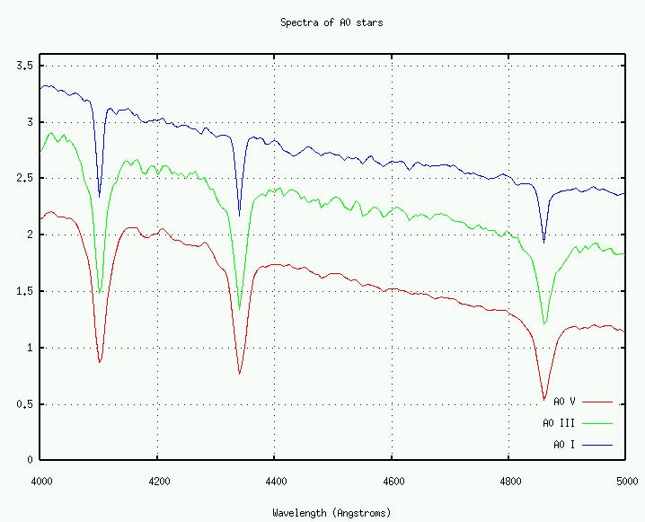
Luminosity class
The luminosity class is assigned a roman numeral: I II III IV V or VI and is related to the width of the spectral line which we will see is related to the stellar luminosity

Slide 13
These luminosity classes are denoted by Roman numbers as follows:
Ia: Brightest supergiants.
Ib: Less luminous supergiants.
II: Bright giants.
III: Giants.
IV: Subgiants (intermediate between giants and main-sequence stars)
V: Main-sequence stars.

Slide 14
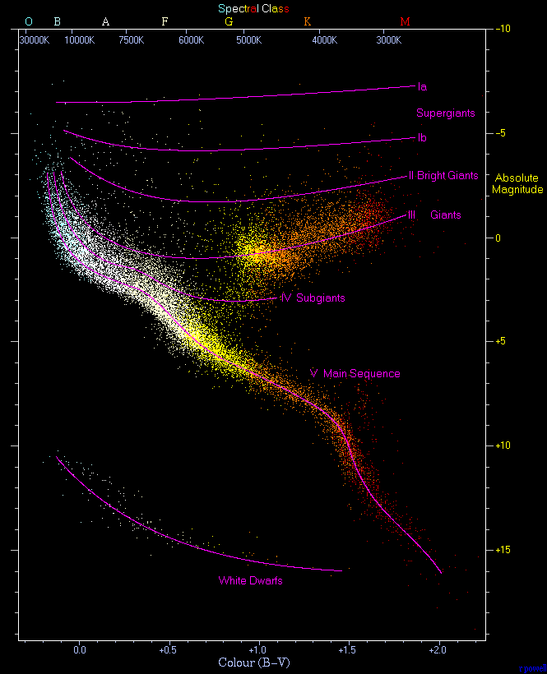
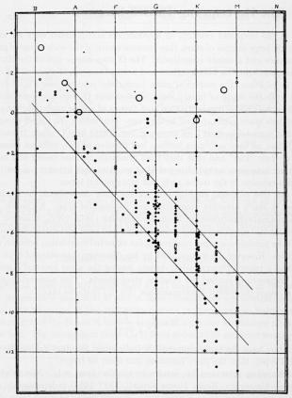
The HR diagram revisited
Luminosity
Spectral Class
O B A F G K M
Henry Norris’ original diagram, showing stellar luminosity as a function of spectral class.
The main sequence is clearly visible

Slide 15
Spectroscopic parallax
In principle, you can identify both the spectral class and the luminosity class from the spectrum.
It is therefore possible to locate the star’s position on the HR diagram and determine it’s absolute magnitude. This can be used to determine the distance to the star. This method is known as spectroscopic parallax

Slide 16
Example
The star Rigel has a spectral type B8Ia and a magnitude V=0.14. What is its distance?

Slide 17
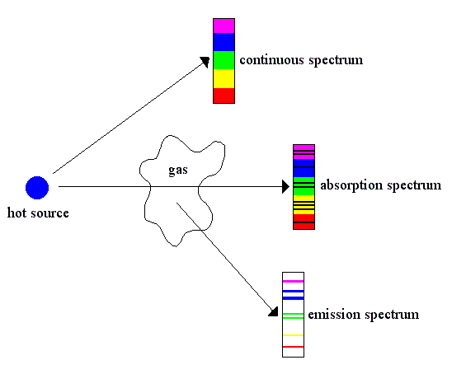
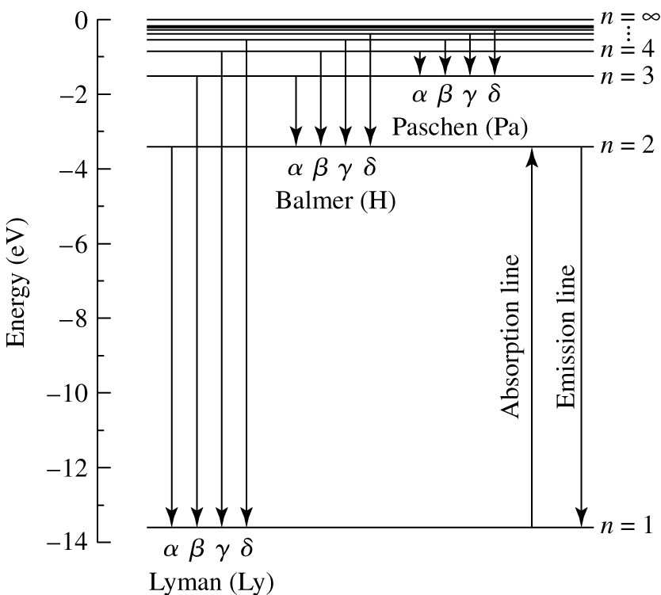
spectrum
A hot, dense gas or hot solid object produces a continuous spectrum with no dark spectral lines
2. A hot, diffuse gas produces bright spectral emission lines
3. A cool, diffuse gas in front of a source of a continuous spectrum produces dark absorption lines in the continuous spectrum

Slide 18
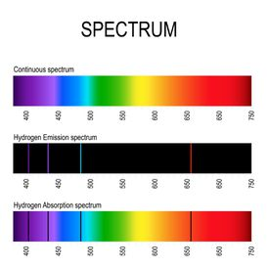

Slide 19
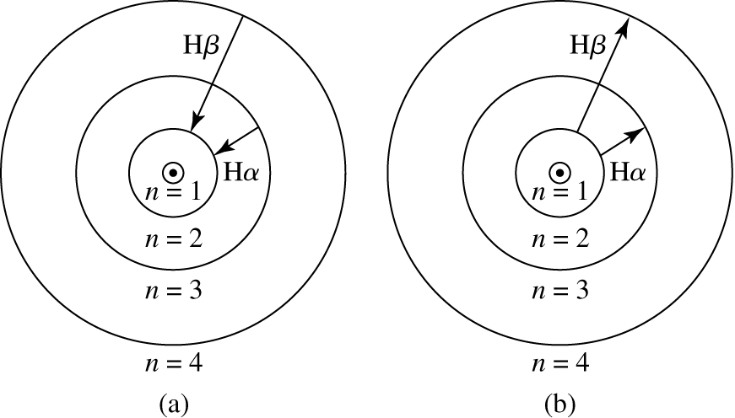
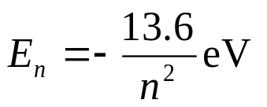
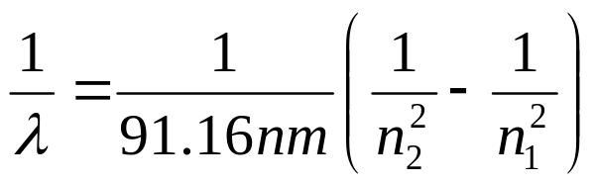
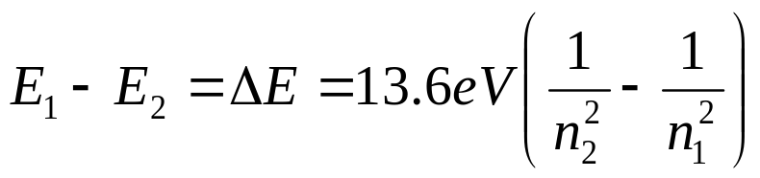
Review: The hydrogen atom
The change in energy is associated with the absorption or emission of a photon. For Hydrogen:
where n is the principal quantum number.
Thus the energy difference between two orbitals n₁ and n₂ of Hydrogen is given by:

Slide 20
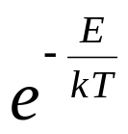
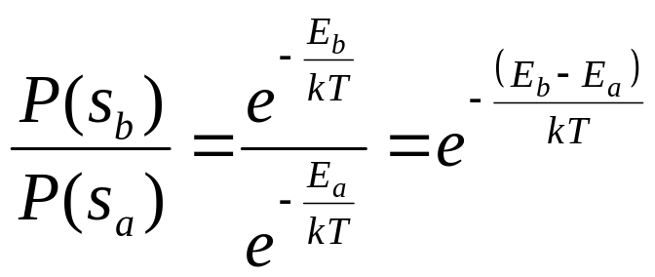
The Boltzmann factor
The probability that an electron is in a given energy level depends on the Boltzmann factor:
Thus the ratio of the probability that an electron is in state s_{b} to the probability that it is in state s_{a} is just:

Slide 21
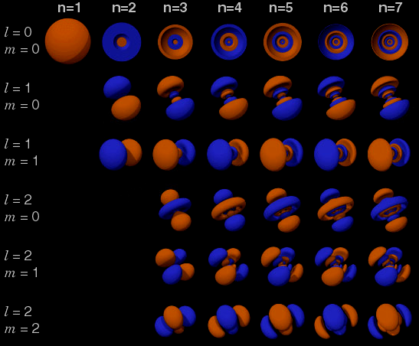
The quantum atom
Electron probability distributions are described by orbitals that are specified by three quantum numbers:
n, l, m_{l}
1. n is the principal quantum number related to the energy of the orbital
2. The angular momentum is quantized to have values of
3. The z-component of angular momentum can only have values of
where m_{l} is an integer between –l and l

Slide 22
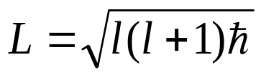
The quantum atom
Electron probability distributions are described by orbitals that are specified by three quantum numbers:
n, l, m_{l}
1. n is the principal quantum number related to the energy of the orbital
2. The angular momentum is quantized to have values of
3. The z-component of angular momentum can only have values of
where m_{l} is an integer between –l and l

Slide 23
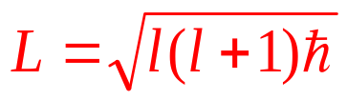
The quantum atom
Electron probability distributions are described by orbitals that are specified by three quantum numbers:
n, l, m_{l}
1. n is the principal quantum number related to the energy of the orbital
2. The angular momentum is quantized to have values of
3. The z-component of angular momentum can only have values of
where m_{l} is an integer between –l and l

Slide 24

The quantum atom
Electron probability distributions are described by orbitals that are specified by three quantum numbers:
n, l, m_{l}
1. n is the principal quantum number related to the energy of the orbital
2. The angular momentum is quantized to have values of
The z-component of angular momentum can only have values of
where m_{l} is an integer between –l and l

Slide 25
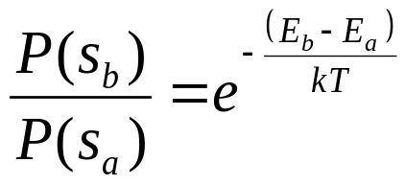
Degeneracies
There may be more than one state with the same energy E. For example, for an isolated Hydrogen atom the quantum numbers associated with spin and angular momentum do not affect the energy
n | l | m_{l} | m_{s} | E (eV)
1 | 0 | 0 | +1/2 | -13.6
1 | 0 | 0 | -1/2 | -13.6
2 | 0 | 0 | +1/2 | -3.4
2 | 0 | 0 | -1/2 | -3.4
2 | 1 | 0 | +1/2 | -3.4
2 | 1 | 0 | -1/2 | -3.4
2 | 1 | 1 | +1/2 | -3.4
2 | 1 | 1 | -1/2 | -3.4
2 | 1 | -1 | +1/2 | -3.4
2 | 1 | -1 | -1/2 | -3.4

Slide 26
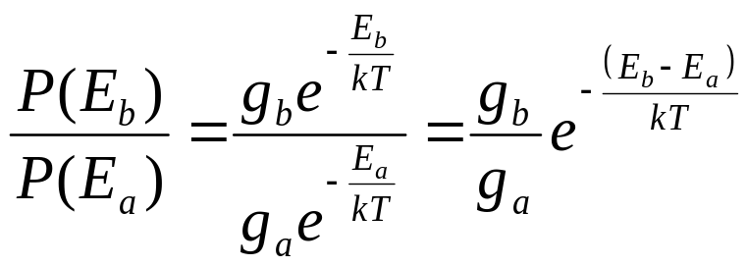

Degeneracies
Therefore the probability that a system will be found in any state with energy E_{b}, relative to the probability that it will be found in any state with energy E_{a} is:
n | l | m_{l} | m_{s} | E (eV)
1 | 0 | 0 | +1/2 | -13.6
1 | 0 | 0 | -1/2 | -13.6
2 | 0 | 0 | +1/2 | -3.4
2 | 0 | 0 | -1/2 | -3.4
2 | 1 | 0 | +1/2 | -3.4
2 | 1 | 0 | -1/2 | -3.4
2 | 1 | 1 | +1/2 | -3.4
2 | 1 | 1 | -1/2 | -3.4
2 | 1 | -1 | +1/2 | -3.4
2 | 1 | -1 | -1/2 | -3.4
For the Hydrogen atom only, the degeneracy depends on the energy level n like:

Slide 27
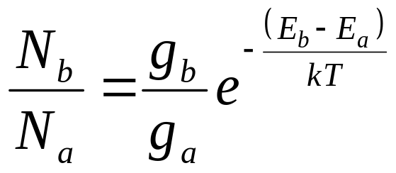
The Boltzmann equation
Since the number of atoms in stellar atmospheres is so large, the ratio of probabilities is essentially equal to the ratio of atoms in each state. This is the Boltzmann equation:

Slide 28
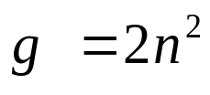
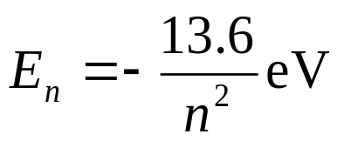
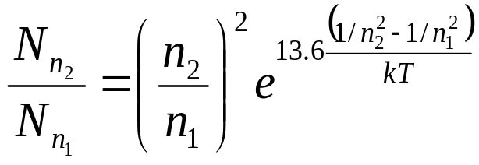
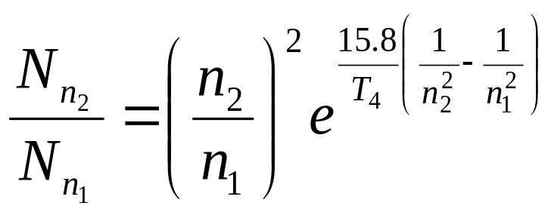
The Boltzmann equation
Since the number of atoms in stellar atmospheres is so large, the ratio of probabilities is essentially equal to the ratio of atoms in each state. This is the Boltzmann equation:
For Hydrogen, where
and
Using k=8.6174x10⁻⁵ eV/K and defining T₄= T/10000K

Slide 29
Example
For a gas of neutral Hydrogen atoms at room temperature, what is the ratio of the number of electrons in the n=2 state to the number in the n=1 state?
What temperature do you need to get a significant number (say 10%) of electrons into the n=2 state (for a neutral Hydrogen gas)?

Slide 30
Puzzling…
The Balmer sequence of absorption lines is due to the transition from n=2 to n>2.
The strength of the Balmer lines is largest for A0 stars, which have temperatures ~9520 K
But we just found you need temperatures ~3 times larger than this to get even 10% of electrons into the n=2 state; and this n=2 population will increase further with increasing temperature.

Slide 31
Break

Slide 32
Ionization
So far we have just dealt with neutral atoms. However, if the temperature gets high enough, electrons can be entirely removed from the atom.
Let’s define χ_{i} to be the energy required to remove an electron from an atom. This increases its ionization state from i to i+1
Ionization states are usually denoted by Roman numerals. So the neutral hydrogen atom is HI and the first ionization state is HII and so on.
Eg. It takes 13.6 eV of energy to remove an electron in the ground state of Hydrogen. So χ_{I}=13.6 eV.

Slide 33
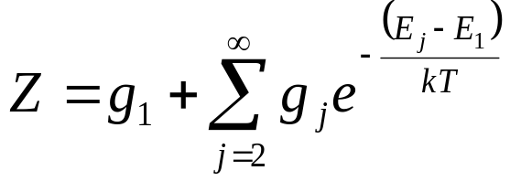

Partition functions
We want to compute the number of atoms in ionization state i+1 relative to the number in ionization state i.
To do this we need to sum over all possible orbital distributions of each state. i.e. how could the electrons be distributed in each ionization state?
The sum of the number of configurations, weighted by the probability of each configuration, is the partition function:

Slide 34
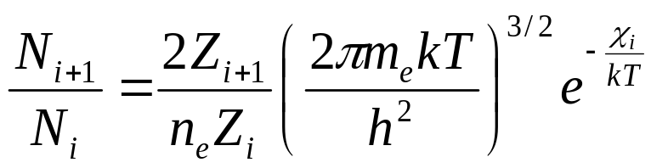
The Saha Equation
In 1920, Meghnad Saha derived an equation for the relative number of atoms in each ionization state. We’ll just present the result:
Note:
  This depends on the number density of electrons, n_{e}. This is because as the number of free electrons increases, it is more likely that they can recombine with an atom and lower the ionization state.
  The Boltzmann factor exp(-χ_{i}/kT) means it is more difficult to ionize atoms with high ionization potentials

Slide 35
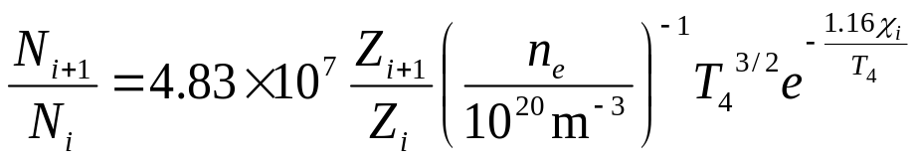
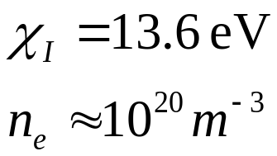
Example: typical Hydrogen atmospheres
Evaluate the partition functions

Slide 36
Example: typical Hydrogen atmospheres
Evaluate the partition functions
Hydrogen has only one electron, so there is only HI (neutral) and HII (ionized).
HII is just a proton: there is only one state, so Z_{II}=1
We saw that, for T<10⁴K, most of the electrons in neutral Hydrogen are in the ground state. Thus Z_{I}~g₁=2

Slide 37
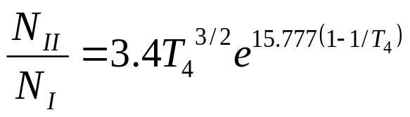
Example: typical Hydrogen atmospheres
where T₄ =T/(10,000K)
T(K) | T₄ | N_{II}/N_{I} | N_{II}/(N_{I}+N_{II})
5500 | 0.55 | 3.4×10⁻⁶ | 3.4×10⁻⁶
8000 | 0.8 | 0.047 | 0.045
9000 | 0.9 | 0.50 | 0.33
10000 | 1 | 3.4 | 0.77
15000 | 1.5 | 1201 | 0.9992
20000 | 2 | 25640 | 0.99996

Slide 38
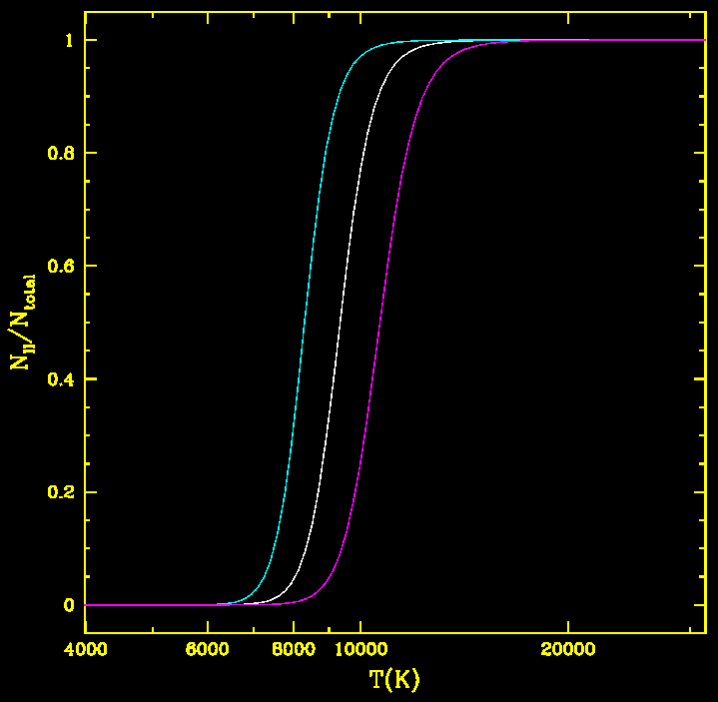
Example: typical Hydrogen atmospheres
Ionization fraction as a function of temperature for 3 different electron densities:
n_{e}=10²¹ m⁻³
n_{e}=10²⁰ m⁻³
n_{e}=10¹⁹ m⁻³
In the interior of stars, temperature decreases from the core to the surface. The narrow region inside a star where Hydrogen is partially ionized is called the hydrogen partial ionization zone

Slide 39
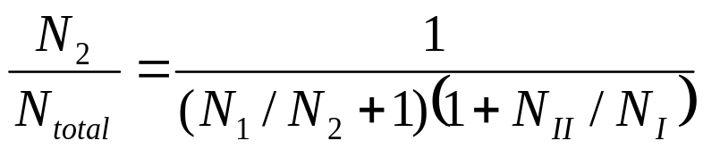
Balmer line formation
Calculate the relative strength of the Balmer absorption lines as a function of temperature
T | N₁/N₂ | N_{II}/N_{I} | N₂/N_{total}
4000 | 1.6x10¹² | 4.3x10⁻¹¹ | 6.2x10⁻¹³
5000 | 4.4x10⁹ | 1.6x10⁻⁷ | 2.3x10⁻¹⁰
9000 | 1.2x10⁵ | 0.50 | 5.5x10⁻⁶
15000 | 652 | 1203 | 1.3x10⁻⁶
20000 | 91 | 2.6x10⁴ | 4.2x10⁻⁷

Slide 40
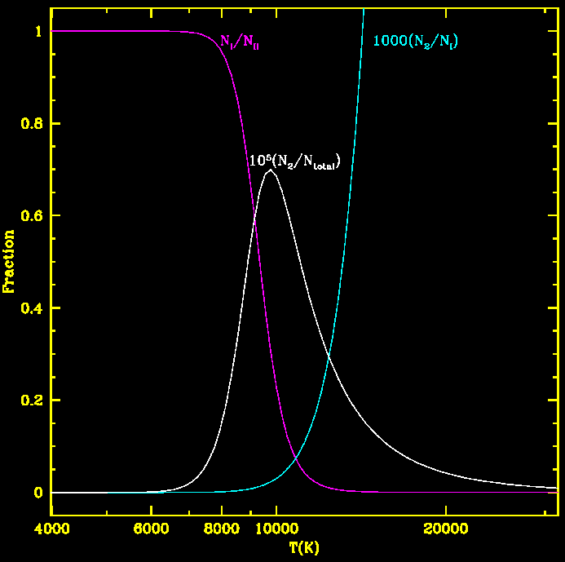
Balmer line formation
This shows why Balmer lines are strongest at ~9000 K. They quickly get weaker at higher temperatures because the ionization fraction increases.

Slide 41
Boltzmann and Saha equations: applicability
Saha equation depends on electron density
  10% of the atoms in a real star are Helium. Ionized Helium increases n_{e}, and therefore decreases the ionization fraction of H at a fixed temperature
These equations only apply if the gas is in thermal equilibrium
The energy levels of H were calculated for an isolated atom. If the gas density gets too large (~1 kg/m³) this is no longer a good approximation, and the ionization energy becomes lower than 13.6 eV.
  (recall the average density in the Sun is ~1410 kg/m³)

Slide 42
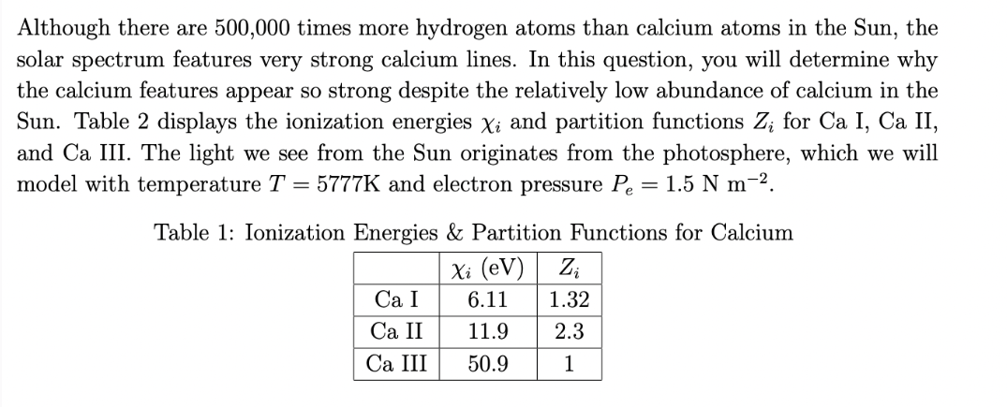


Slide 43
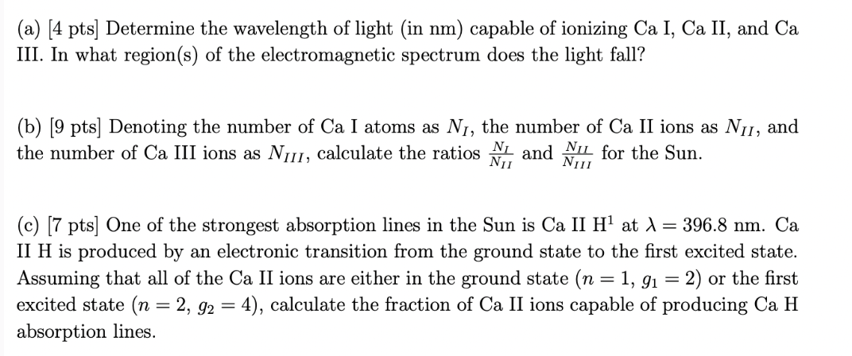
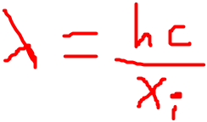

Slide 44
Calcium lines are strong in the solar spectrum for several reasons:
Calcium is abundant.
Although there are 500,000 times more hydrogen atoms than calcium atoms in the Sun, calcium is still the fifth most abundant element by mass.
Calcium has a low first ionization potential.
This means that it is relatively easy to remove an electron from calcium, creating a calcium ion. Calcium ions are the species that produce most of the strong calcium lines in the solar spectrum.
Calcium has a number of strong transitions.
The energy levels of calcium atoms and ions are such that there are a number of strong transitions between them. This means that photons of the right energy are more likely to be absorbed by calcium atoms, creating absorption lines in the solar spectrum.
The temperature of the solar photosphere is ideal for calcium ionization and excitation.
The photosphere is the layer of the Sun that produces most of the visible light that we see. The temperature of the photosphere is around 5777 K, which is just right for ionizing and exciting calcium atoms.

Slide 45
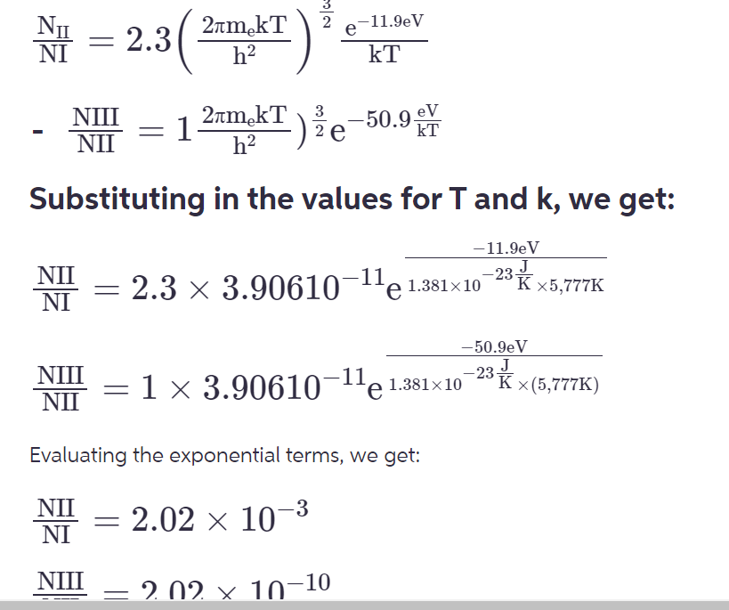

Slide 46
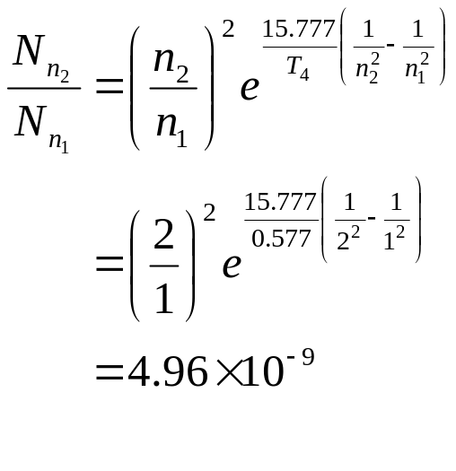
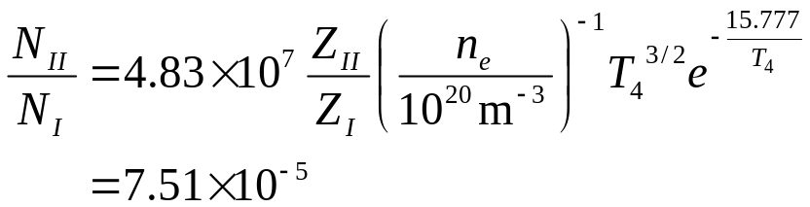

Example: Calcium lines in the Sun
Ca H+K
Hα
The Calcium absorption lines are ~400 times stronger than the Hydrogen lines. How much Calcium is there, relative to Hydrogen? Assume n_{e}=1.88x10¹⁹ m⁻³ and T=5770 K
First, let’s look at hydrogen. The Balmer lines arise due to transitions from the n=2 level of neutral H.
= 1/ 200 million
So almost all the Hydrogen is neutral.
So only 1 of every ~200 million H atoms is in the first excited state (and capable of creating a Balmer absorption line).

Slide 47
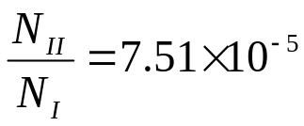
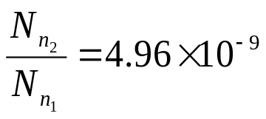
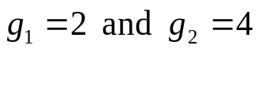
Example: Calcium lines in the Sun
The Calcium absorption lines are ~400 times stronger than the Hydrogen lines. How much Calcium is there, relative to Hydrogen? Assume n_{e}=1.88x10¹⁹ m⁻³ and T=5770 K
For Hydrogen:
Now consider Calcium, for which χ_{I}=6.11 eV
The λ=393.3 nm Calcium line in the sun come from the n=1→2 transition of singly-ionized calcium.
The partition functions are more complicated to compute, so I’ll just give them to you: Z_{I}=1.32 and Z_{II}=2.3
For the Boltzmann equation, I tell you that for singly ionized Calcium

Slide 48

Relative Line Strengths of Different Elements
Let us compute the fraction of singly-ionized calcium atoms (Ca II) in the ground state (capable of producing the Ca II H and K absorption lines) to the total number of calcium atoms in the solar photosphere.
The ionization energy of neutral calcium (to single-ionized calcium) is 6.11 eV, only about half of the 13.6 eV ionization energy of hydrogen.
From the Saha equation, the ratio of singly-ionized to neutral calcium is (Z_{I} = 1.32 and Z_{II} = 2.30 for calcium)
Practically all of the calcium atoms in the solar photosphere are singly-ionized (in the form of Ca II), with only one of every 918 calcium atoms remaining neutral (in the form of Ca I). Note: the ionization energy of Ca II to Ca III is 11.9 eV, and so there are very few doubly-ionized calcium atoms (Ca III).

Slide 49
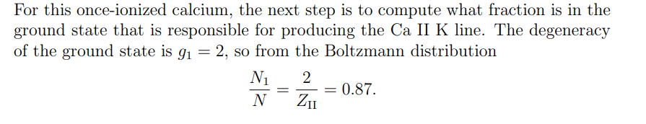

Slide 50
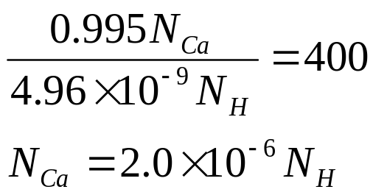
Example: Calcium lines in the Sun
The Calcium absorption lines are ~400 times stronger than the Hydrogen lines. How much Calcium is there, relative to Hydrogen? Assume n_{e}=1.88x10¹³ and T=5770 K
We have found that only 4.8x10⁻⁹ of H atoms are in the first excited state (to produce Balmer lines), whereas 99.5% of Ca atoms are in the ground, singly-ionized state (to produce the solar absorption lines).
  Since the Ca lines are ~400 times stronger, this means:
There is only one Ca atom for every 520,000 H atoms.
The difference: Ca is easier to ionize than H (χ_{I}=6.11 instead of 13.6), and Ca has more than 1 electron, so is able to emit radiation in the singly-ionized state!

